Slide 2
Christians First In Antioch

Slide 3
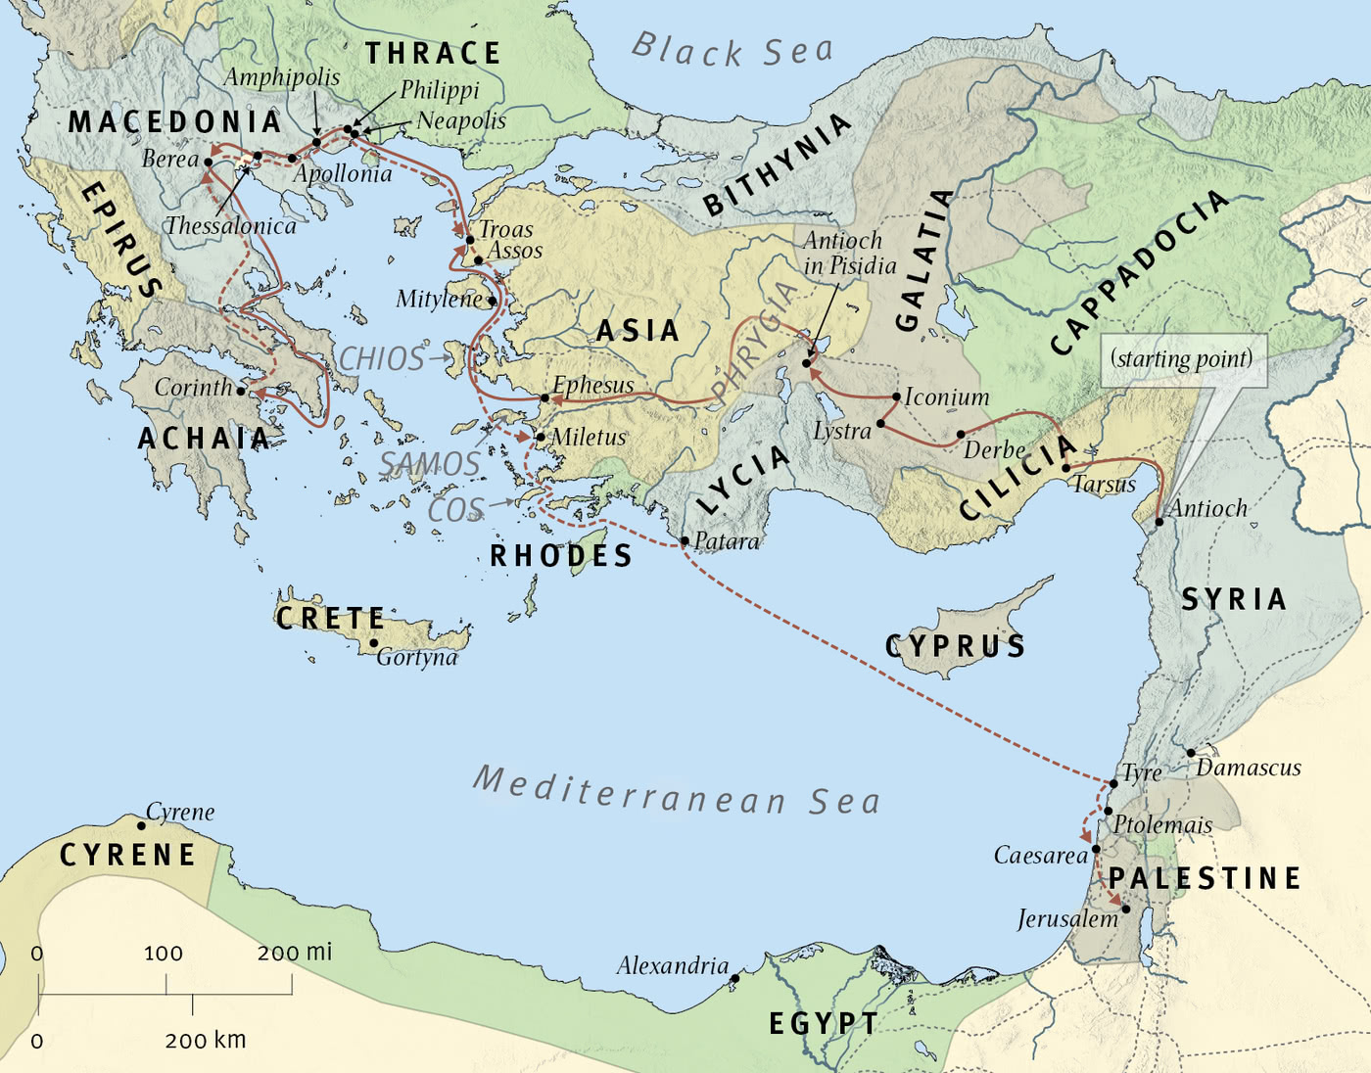

Slide 4
Antioch of Syria
Founded c. 300 B.C. by Seleucus I Nicanor, son of Antiochus
Not the Antioch of Pisidia (Acts 13:14)
Made up of Greeks, Macedonians, local Syrians, Jews, and Romans
Capital of Syria near the Orontes River

Slide 5
Antioch of Syria
Third largest Roman city behind Rome and Alexandria; 200-600 thousand
Jews enjoyed the privilege of a Roman political state (politeuma)
First mentioned in Acts 6:7

Slide 6
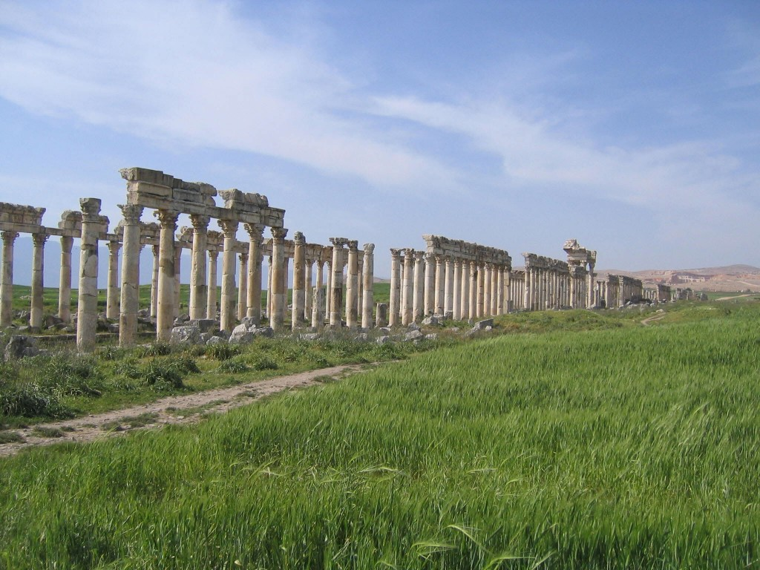

Slide 7
The Church At Antioch
1. They were completely dedicated to the Lord (Acts 11:19-26)
2. They were generously benevolent toward the needy (Acts 11:27-30)
3. They were highly educated in the gospel (Acts 13:1; see 11:26; 15:35)

Slide 8
The Church At Antioch
4. They were energetically evangelistic toward the lost (Acts 13:2-3; 14:26-28; 15:36-41; 18:22-23)
5. They were strongly defensive of the truth (Acts 15:1-3, 30-35; see Gal. 2:11)

Slide 9
Antioch: The Model For Today
Dedicated or half-hearted (Heb. 10:22)?
Benevolent or greedy (2 Cor. 9:6)?
Educated or ignorant (Eph. 5:17)?
Evangelistic or uncaring (Jude 22-23)?
Defensive or weak (Jude 3)?

